Slide 1
Capstone Project
Seoul Bike Sharing Demand Prediction
Presented By- Pradeep Gupta

Slide 2
Content
Wrangling the data
Dealing with special characters in the dataset
Checked for null and duplicate values
Converting column from datetime to object
Extracting months and days from date
Creating dummies for some columns
Checking distribution of data in rented bike count using skewness
Checking distribution of other features using skewness
2. Implementing Regression Techniques

Slide 3
Problem Statement
Currently Rental bikes are introduced in many urban cities for the enhancement of mobility comfort. It is important to make the rental bike available and accessible to the public at the right time as it lessens the waiting time. Eventually, providing the city with a stable supply of rental bikes becomes a major concern. The crucial part is the prediction of bike count required at each hour for the stable supply of rental bikes.

Slide 4
Data Summary
Data set name- Bike Sharing Demand Prediction
Shape of dataset- 8760 Rows, 13 Columns
Columns- ‘Rented Bike Count’, ‘Hour’, ‘Temperature(°C)’, ‘Humidity(%)’, ‘Wind speed (m/s)’, ‘Visibility (10m)’, ‘Dew point temperature(°C)’, ‘Solar Radiation (MJ/m2)’, ‘Rainfall(mm)’, ‘Snowfall (cm)’, ‘Seasons’, ‘Holiday’, ‘Functioning Day’

Slide 5
Cleaning the dataset
I have taken ‘Date’ as index.
I have checked for null values but there wasn’t any null values.
I also checked for duplicated values but there wasn’t any.
Column ‘Hour’ has data type as integer while it is timestamp so treated it like object.
I have split the ‘Date’ into ‘Year’, ’Month’ and ‘Day’

Slide 6
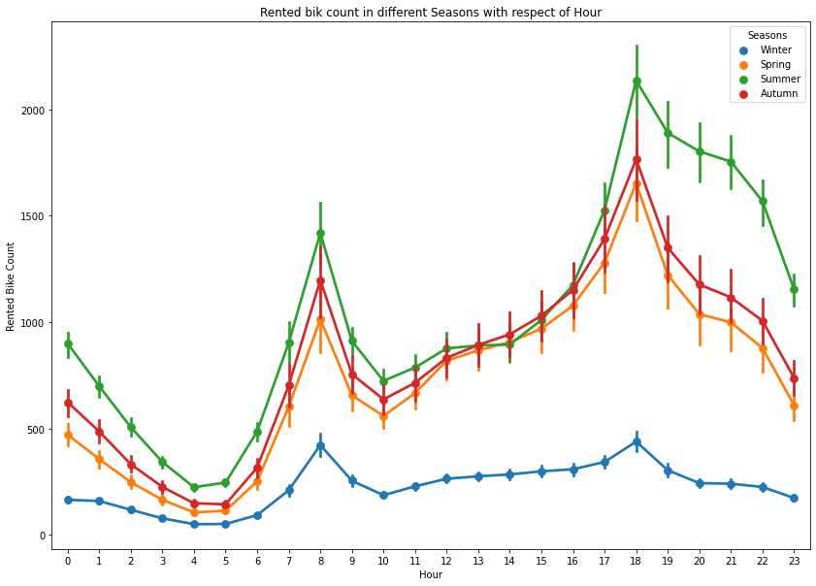
Seasons
We can see the demand is high in Summer season and lowest in Winter season.

Slide 7
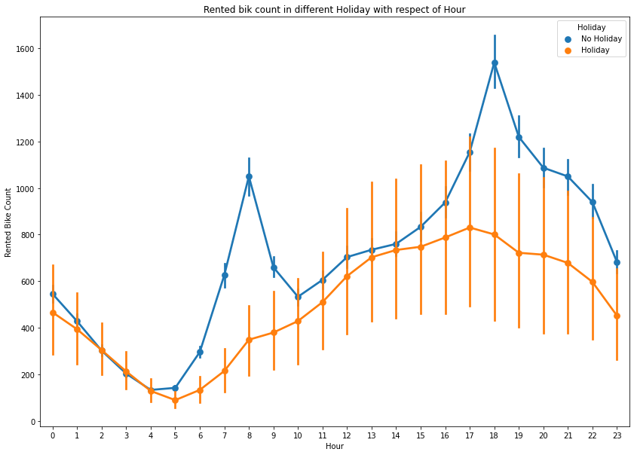
Holiday
The demand of bikes on Holiday is less as compare to No holiday.
Average number of bikes rented on Holiday – 500
Average number of bikes rented on Non holiday -715

Slide 8
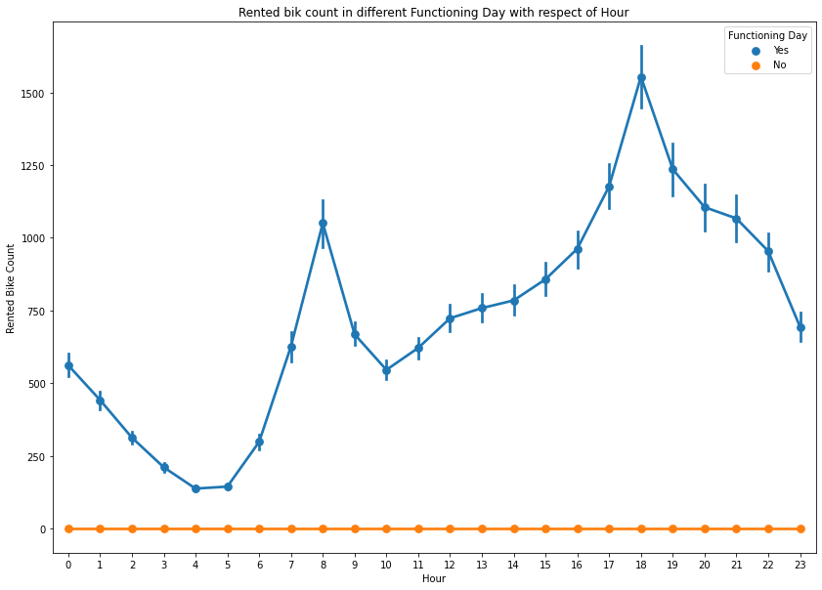
Functioning Hours
There is no demand of bikes if there is no functioning hours.

Slide 9
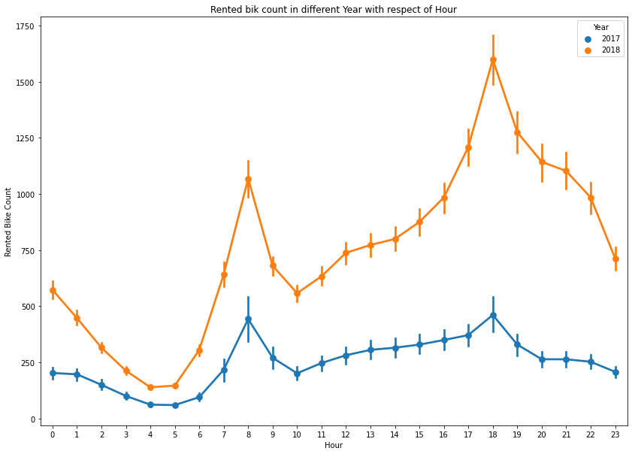
Hour
The demand of bikes in 17 to 21 hours is high followed by 7 to 9 hour. May be some people like to go from office by bike.

Slide 10
Year
No of bikes rented in 2017 is less because its started in December 2017.

Slide 11
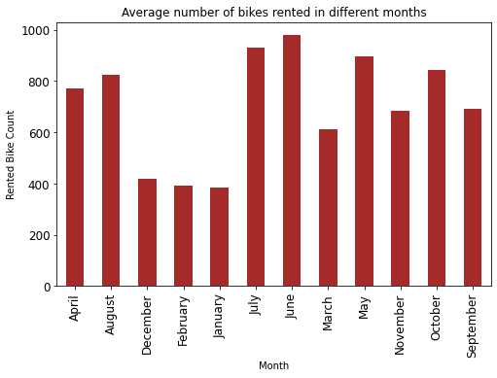
Month
Demand for bike was higher in June and July while its demand was lowest in December, January and February.

Slide 12
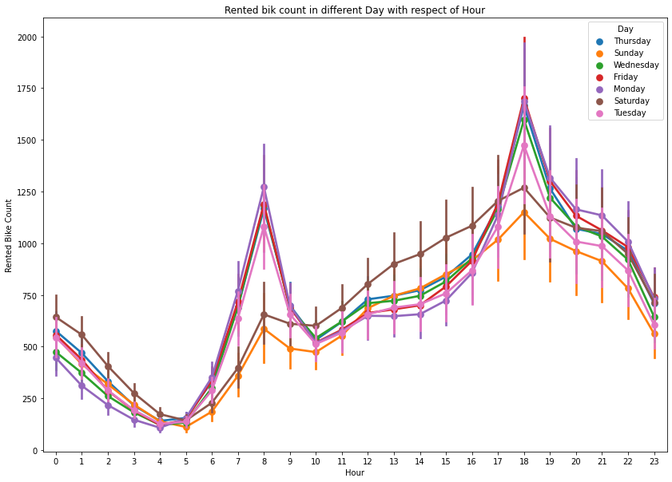
Day
The demand of bike was less on Saturday and Sunday may be because of weekend.

Slide 13
Average number of bikes rented on each Seasons
Average number of bikes rented in Summer – 1034
Average number of bikes rented in Autumn -820
Average number of bikes rented in Spring- 730
Average number of bikes rented in Winter - 226
Average number of bikes rented on each Day
Average number of bikes rented on Monday – 720
Average number of bikes rented on Tuesday – 678
Average number of bikes rented on Wednesday – 715
Average number of bikes rented on Thursday – 744
Average number of bikes rented on Friday – 734
Average number of bikes rented on Saturday – 730
Average number of bikes rented on Sunday – 616

Slide 14
Average number of bikes rented in each Hour
Average number of bikes rented on 0 - 541 Average number of bikes rented on 1 - 426 Average number of bikes rented on 2 - 302 Average number of bikes rented on 3 - 203 Average number of bikes rented on 4 – 133 Average number of bikes rented on 5 – 139 Average number of bikes rented on 6 – 288 Average number of bikes rented on 7 – 606 Average number of bikes rented on 8 – 1016 Average number of bikes rented on 9– 646 Average number of bikes rented on 10 – 528 Average number of bikes rented on 11 – 601 | Average number of bikes rented on 12 - 699 Average number of bikes rented on 13- 733 Average number of bikes rented on 14 - 759 Average number of bikes rented on 15 - 829 Average number of bikes rented on 16 – 931 Average number of bikes rented on 17 – 1138 Average number of bikes rented on 18 – 1503 Average number of bikes rented on 19 – 1195 Average number of bikes rented on 20 – 1069 Average number of bikes rented on 21– 1031 Average number of bikes rented on 22 – 923 Average number of bikes rented on 23 – 671

Slide 15
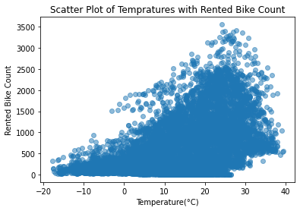
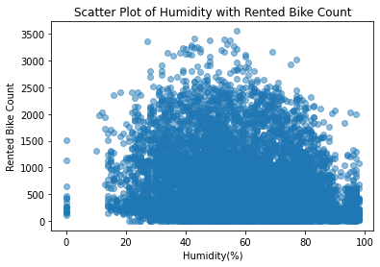
Relationship b/w Rented bike count and other Features
We can see Temperature has positive linear relation with Rented bike count means the demand of bike increasing as the temperature increases also if temperature increases after a certain point the demand of bike decreases, Humidity has slightly negative linear relation.

Slide 16
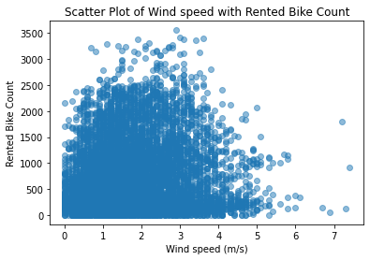
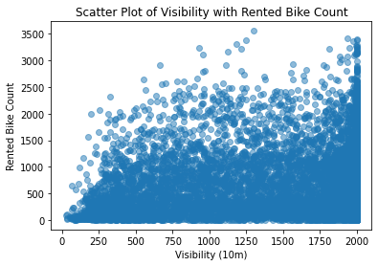
Relationship b/w Rented bike count and other Features
Wind speed and Visibility both has positive linear relation with Rented Bike Count.

Slide 17
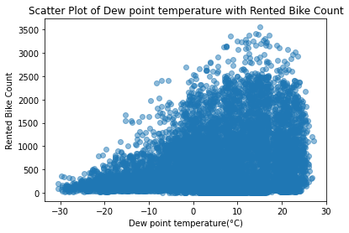
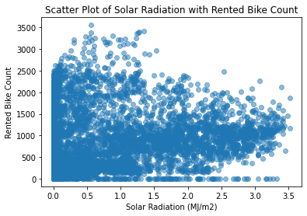
Relationship b/w Rented bike count and other Features
Dew point temperature and Solar Radiation both has positive linear relation with Rented Bike Count

Slide 18
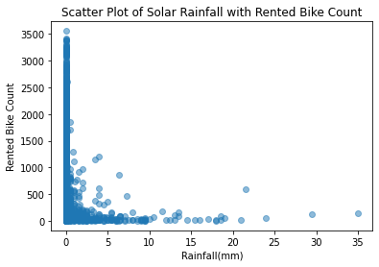
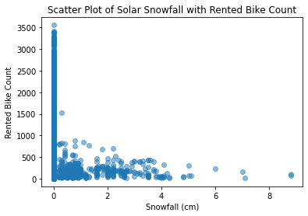
Relationship b/w Rented bike count and other Features
We can see Rainfall and Snowfall both has negative linear relation with Rented bike count means the demand of bike is very low if the rainfall or snowfall starts.

Slide 19
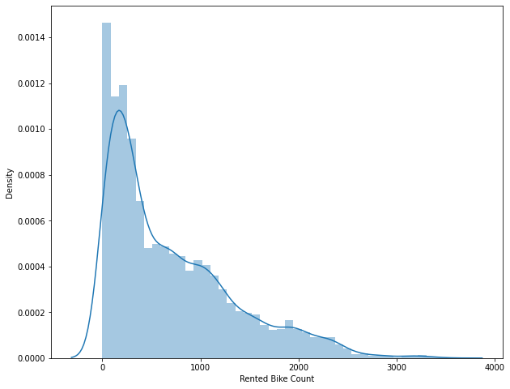
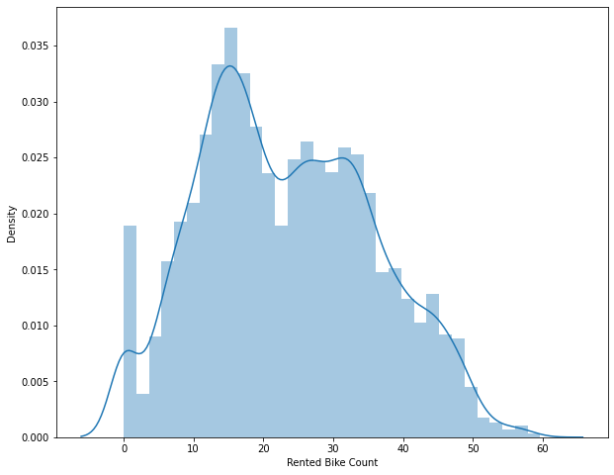
Rented Bike Count Distribution
Rightly skewed distribution changes to normal distribution to some extent using sqrt.

Slide 20
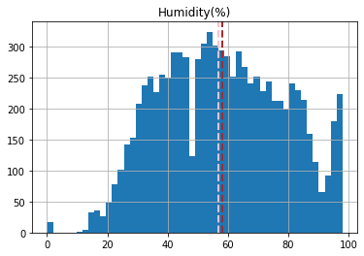
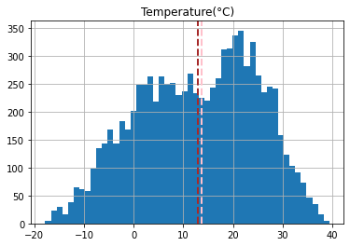
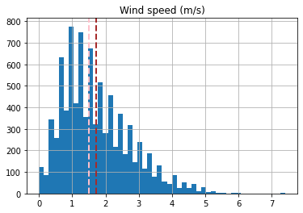
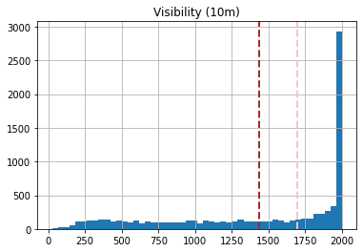
Distribution in Independent Features

Slide 21
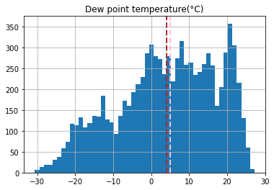
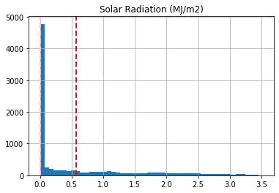
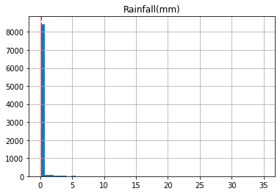
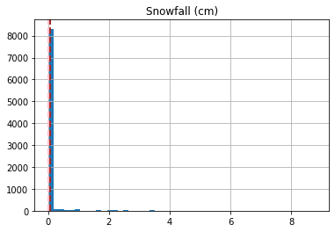
Distribution in Independent Features

Slide 22
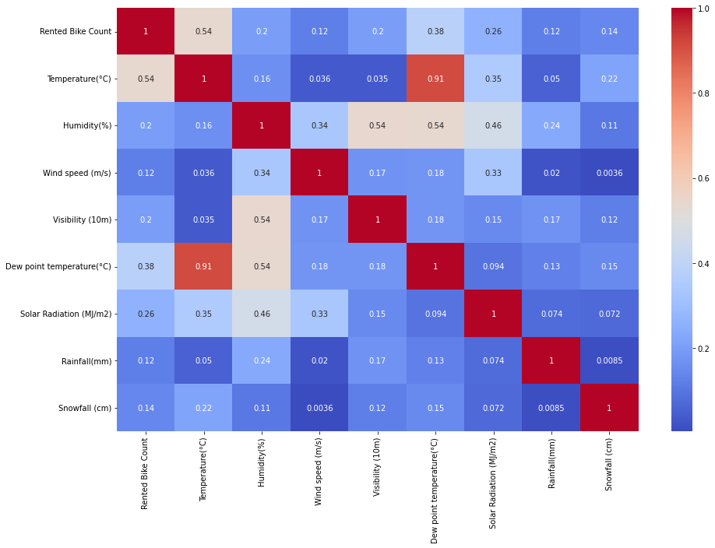
Heatmap to find Multicollinearity

Slide 23
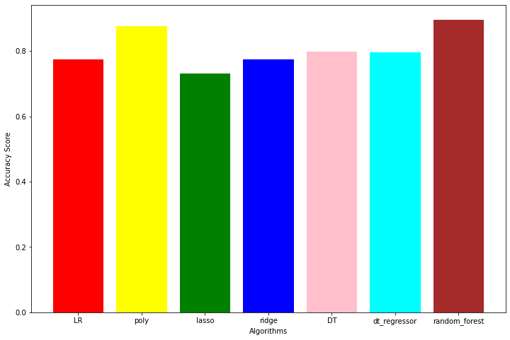
Regressions
Accuracies by different algorithms –
Linear Regression – 77%
Polynomial Regression – 88%
Lasso – 73%
Ridge – 78%
Decision Tree – 80%
Cross Validation with Decision Tree – 79%
Random Forest – 90%

Slide 24
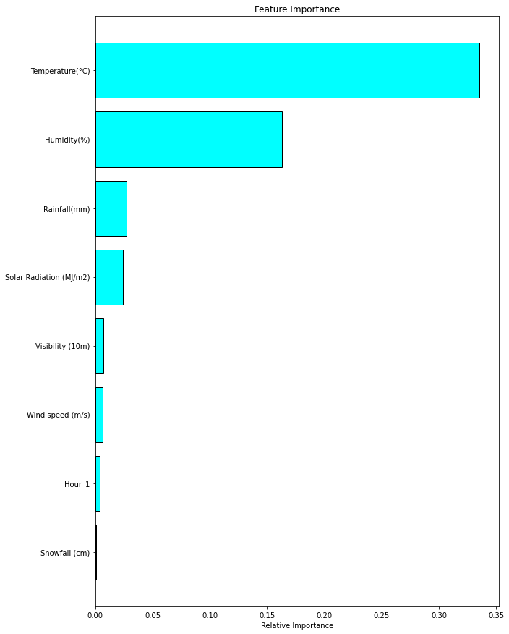
Feature Importance

Slide 25
Conclusions
Average demand of bikes in Summer season is 1034 which is highest and average demand of bike in Winter season is 226 which is lowest.
Average demand of bike in Autumn is 820 and in Spring season it is 730.
The demand of bikes is zero on non functioning hours.
Demand of bikes for rent is less on holiday(approx. 500) as compare to no holiday(approx. 715).
Demand of bikes for rent is highest in evening 5PM to 9PM(approx. 5936 bikes in these hours). Demand also increases in morning 8AM(approx. 1016).
Demand of bikes is less in December, January and February (approx. 1098 bikes in these months). That’s because of Winter as we saw above demand of bikes in Winter is lowest. Demand is highest in June and July month(approx. 1911 bikes).
Less bikes rented on weekends in compare to working days.
Random Forest is best fit for this dataset problem.

